Slide 1
GILDED
Covered thinly with gold leaf or gold paint
an elegant gilded birdcage

Slide 2
The Nature of Politics
1870-1895 American politics…
“was poor in purpose and barren in results” Henry Adams
Although, 80-90% of eligible voters cast ballots!
Politics was also main focus of entertainment!!!
More than baseball, vaudeville and circuses…

Slide 3
Party Allegiances
Politics was personal/community activity!
Loyalties to politicians and parties!
No major “faction” or party gained control (1877-1897)
Repub. (3 terms) Dems. (2 terms) Presidency
Only 6 years was there unilateral control of Congress and the Executive!

Slide 4
The
"Politics of
Equilibrium"

Slide 5
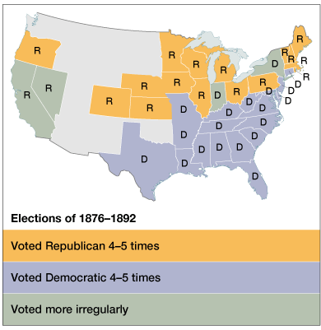
1. A Two-Party Stalemate

Slide 6
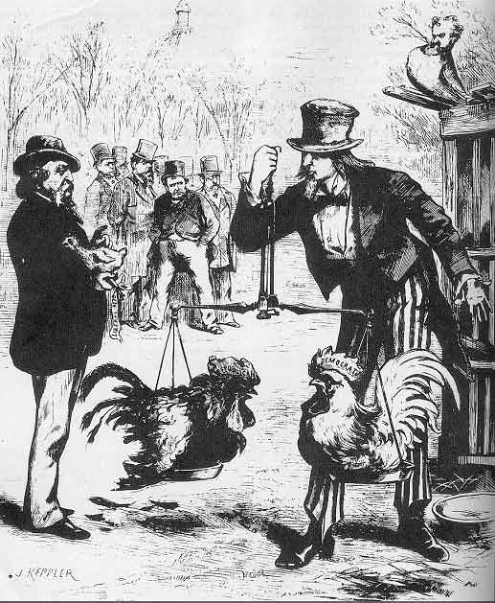
Two-Party “Balance”

Slide 7
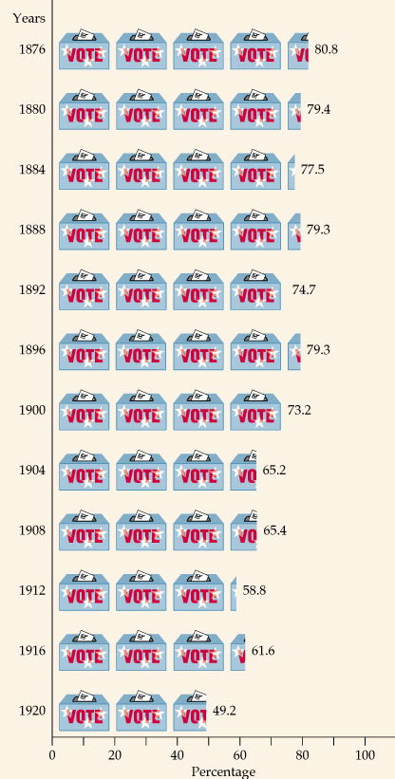
2. Intense Voter Loyalty to the Two Major Political Parties

Slide 8
3. Well-Defined Voting Blocs
Democratic Bloc
Republican Bloc
White southerners (preservation of white supremacy)
Catholics
Recent immigrants (esp. Jews)
Urban working poor (pro-labor)
Most farmers
Northern whites (pro-business)
African Americans
Northern Protestants
(support for anti-immigrant laws)
Most of the middle class

Slide 9
4. Very Laissez Faire Federal Govt.
From 1870-1900 → Govt. did very little domestically.
Main duties of the federal govt.:
Deliver the mail.
Maintain a national military.
Collect taxes & tariffs.
Conduct a foreign policy.
Exception → administer the annual Civil War veterans’ pension.

Slide 10
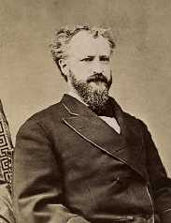
5. The Presidency as a Symbolic Office
Party bosses ruled.
Presidents should avoid offending any factions within their own party.
The President just doled out federal jobs.
1865 → 53,000 people worked for the federal govt.
1890 → 166,000 “ “ “ “ “ “
Senator Roscoe Conkling

Slide 11
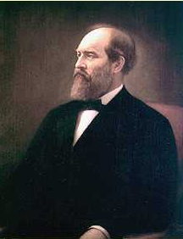
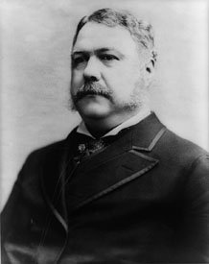
1880 Presidential Election: Republicans
Half Breeds
Stalwarts
Sen. James G. Blaine Sen. Roscoe Conkling (Maine) (New York)
compromise
James A. Garfield Chester A. Arthur (VP)

Slide 12
More specifically factional feuds and personal rivalries took priority over national concerns
Half-Breeds
Stalwarts
Were corrupt and wanted to please their party supporters, but disguised their aims by courting support from “Independents”
Party influence and government jobs for his supporters

Slide 13
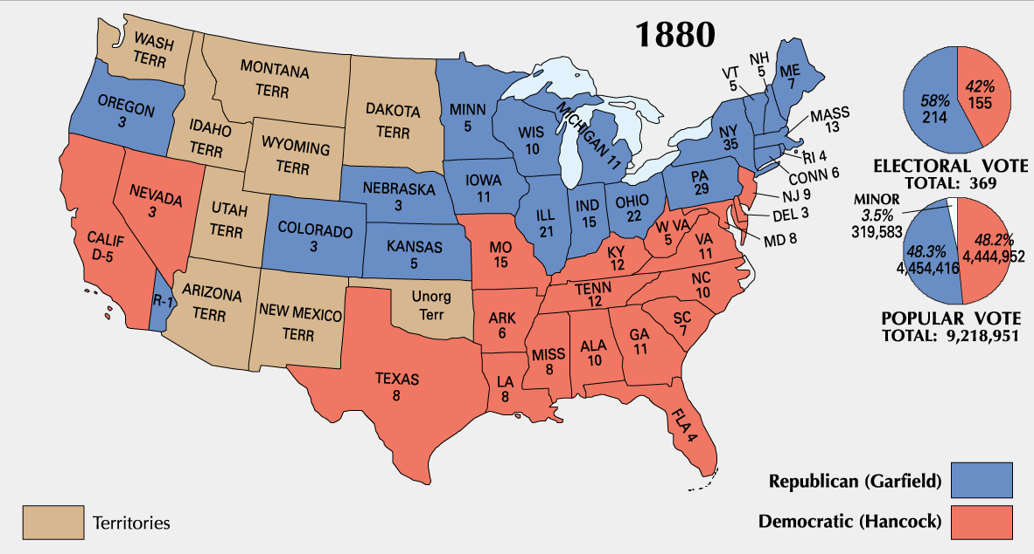
1880 Presidential Election

Slide 14
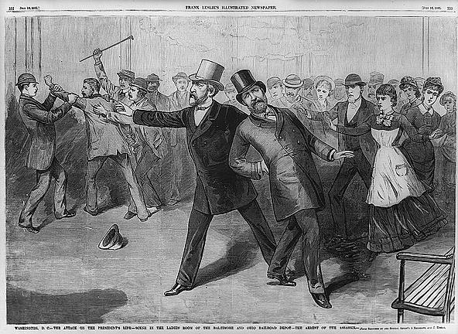
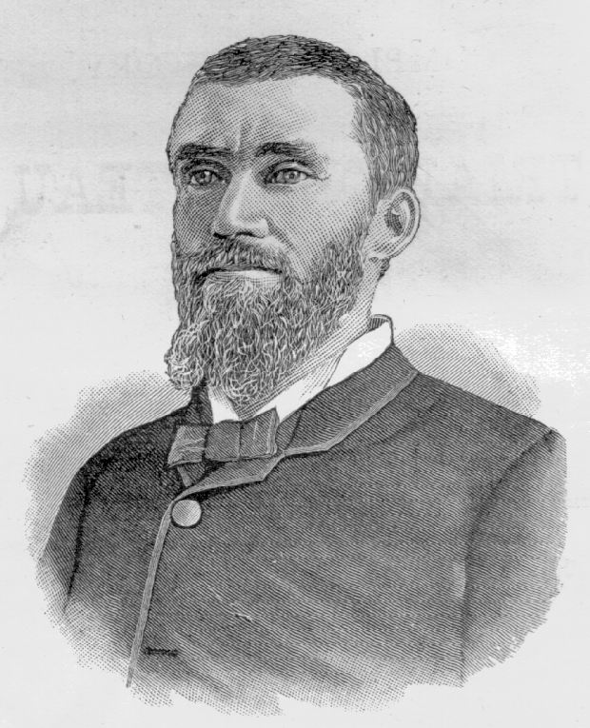
1881: Garfield Assassinated!
Charles Guiteau: I Am a Stalwart, and Arthur is President now!

Slide 15
Civil Service Reform
Attacking the “Jackson” era spoils system…
The practice of awarding government jobs to party workers, regardless of their qualifications. (and this was in wide practice after the civil war)
What are your thoughts on how the spoils system impacted this time period?

Slide 16
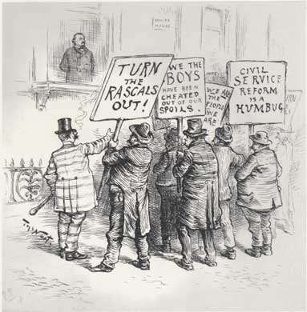
Pendleton Act (1883)
Civil Service Act.
The “Magna Carta” of civil service reform.
1883 → 14,000 out of 117,000 federal govt. jobs became civil service exam positions.
1900 → 100,000 out of 200,000 civil service federal govt. jobs.

Slide 17
Mugwumps
Native American term meaning
“Undisciplined Chiefs”

Slide 18
Republican “Mugwumps”
Reformers who wouldn’t re-nominate Chester A. Arthur.
Reform to them → create a disinterested, impartial govt. run by an educated elite like themselves.
Social Darwinists.
Laissez faire government to them:
Favoritism & the spoils system seen as govt. intervention in society.
Their target was political corruption, not social or economic reform!

Slide 19
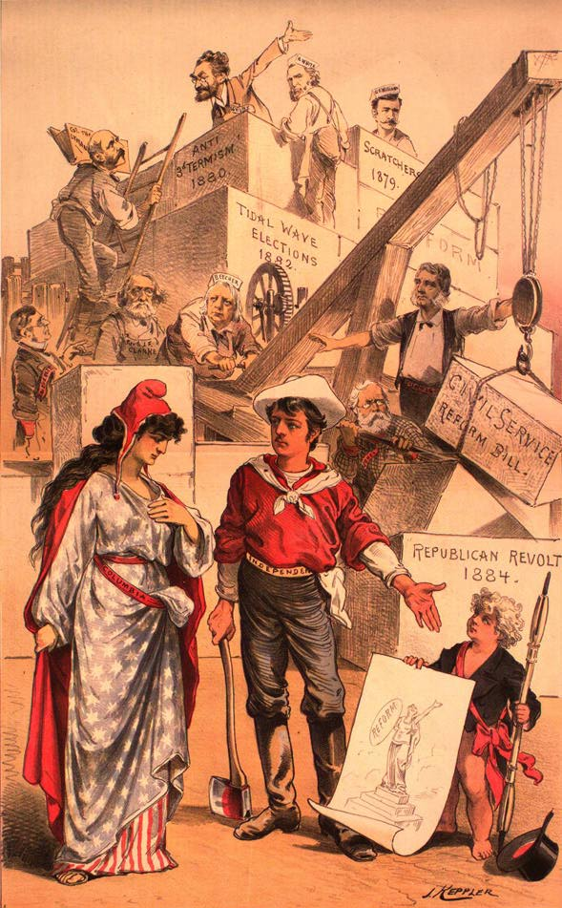
The Mugwumps
Men may come and men may go, but the work of reform shall go on forever.
Will support Cleveland in the 1884 election.

Slide 20
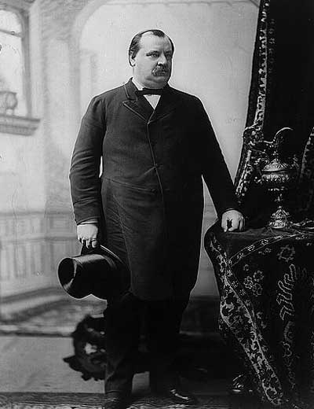
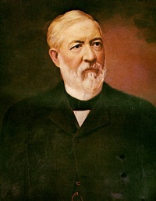
1884 Presidential Election
Grover Cleveland James Blaine * (DEM) (REP)

Slide 21
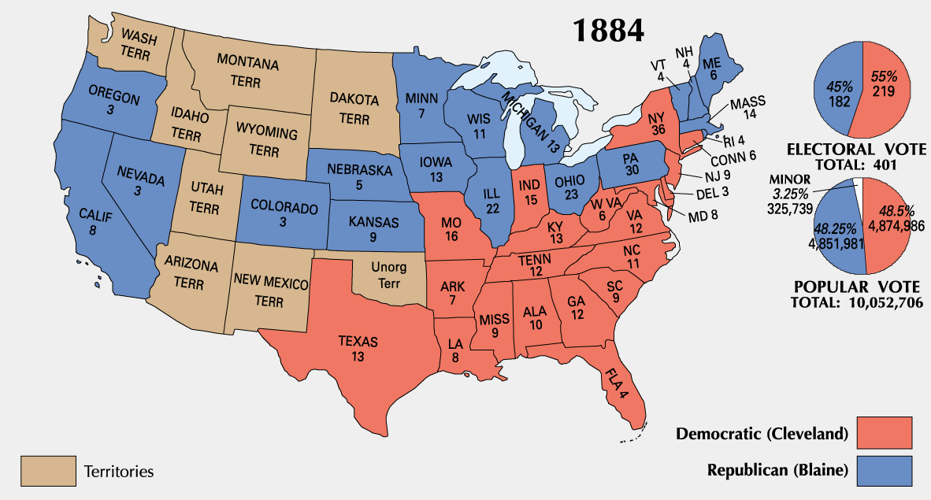
1884 Presidential Election

Slide 22
Cleveland’s First Term
The “Veto Governor” from New York.
First Democratic elected since 1856.
A public office is a public trust!
His laissez-faire presidency:
Opposed bills to assist the poor as well as the rich.
Vetoed over 200 special pension bills for Civil War veterans!

Slide 23
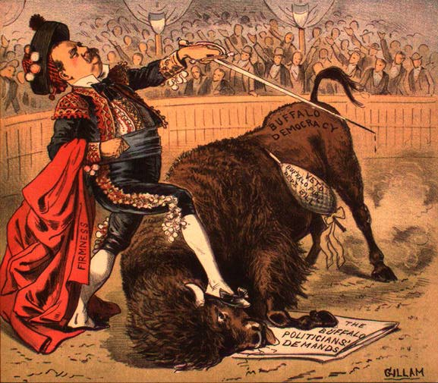
Bravo, Señor Clevelando!

Slide 24
The Tariff Issue
After the Civil War, Congress raised tariffs to protect new US industries.
Big business wanted to continue this; consumers did not.
1885 → tariffs earned the US $100 mil. in surplus!
Mugwumps opposed it
Tariffs became a major issue in the 1888 presidential election.

Slide 25
Happy ½ day Wednesday
Please have your eBook open and logged in!
We will be on page 88
You will also need your yellow FIB packet.

Slide 26
Agenda
1- John Green review of the Industrial Revolution.
2- finish Fill in the Blanks “Gilded Age and Populism”
3- John Green review of “Gilded Age”

Slide 27
Tariff Policy
Congress increase tariffs on imports
Purpose-help protect U.S. goods
Criticism- special interests benefit from these tariffs
Repubs. Supported tariffs
Dems.- tariffs made prices artificially high? Why
Wool manufactures were (protected)
Small Farmers (Not protected)

Slide 28
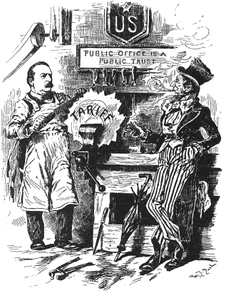
Filing the Rough Edges
Tariff of 1888

Slide 29
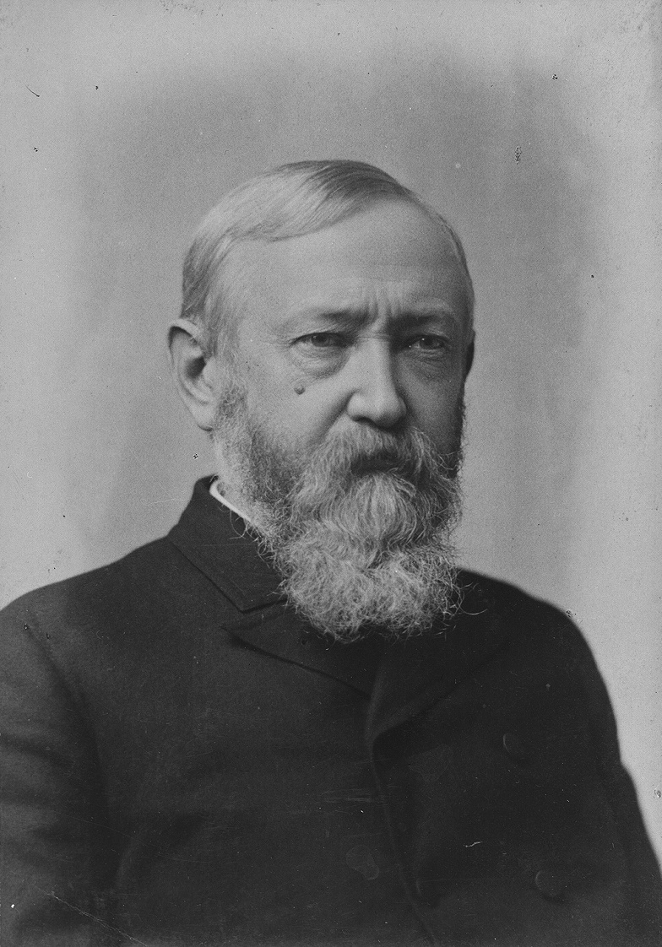
1888 Presidential Election
Grover Cleveland Benjamin Harrison (DEM) * (REP)

Slide 30
John Green standouts
Presidents/back in forth
McKinley assassinated
Electricity
Populists (affordable railroad rates)- People’s Party…
Farmers
Mark Twain-Gilded Age
Progressive movement
Unions/Labor support

Slide 31
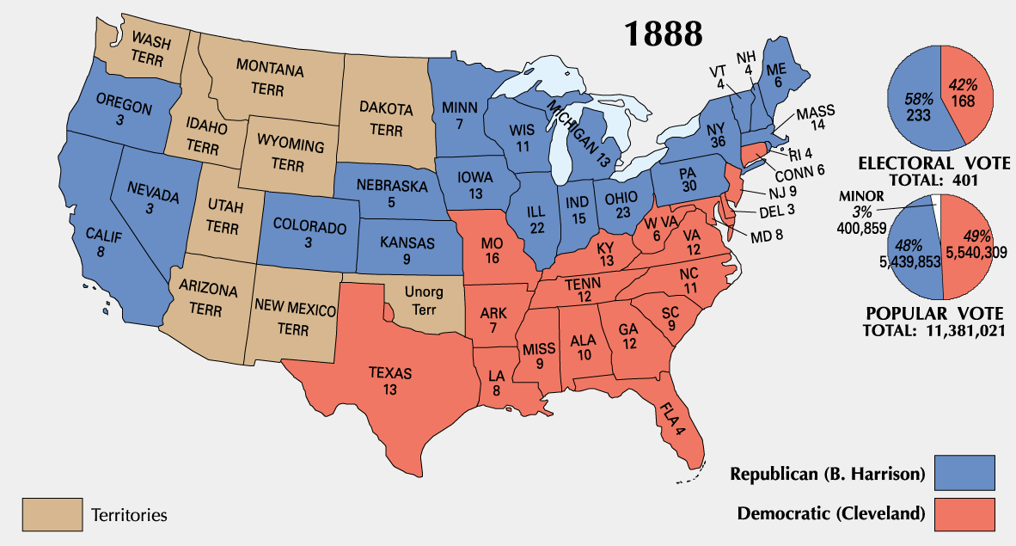
1888 Presidential Election

Slide 32
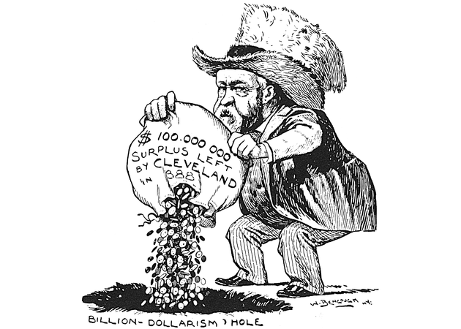
Disposing the Surplus

Slide 33
Changing Public Opinion
Americans wanted the federal govt. to deal with growing soc. & eco. problems & to curb the power of the trusts:
Interstate Commerce Act – 1887
Sherman Antitrust Act – 1890
McKinley Tariff – 1890
Based on the theory that prosperity flowed directly from protectionism.
Increased already high rates another 4%!
Rep. Party suffered big losses in 1890 (even McKinley lost his House seat!).

Slide 34
1892 Presidential Election
Grover Cleveland Benjamin Harrison again! * (DEM) (REP)

Slide 35
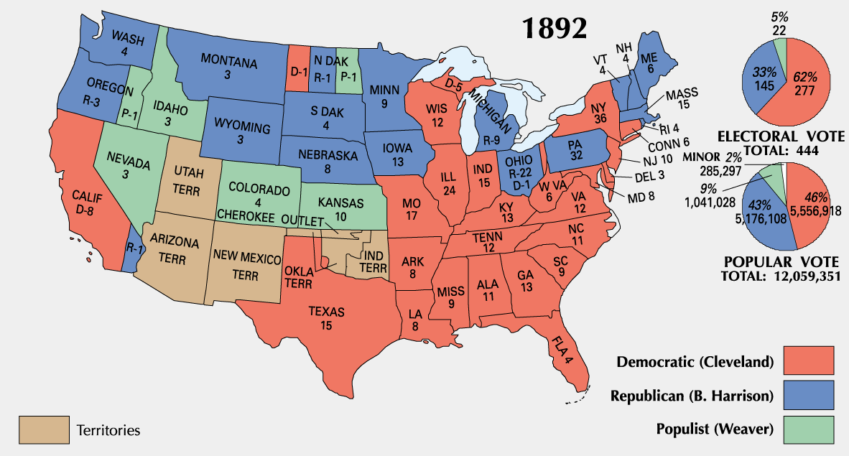
1892 Presidential Election

Slide 36
Cleveland Loses Support Fast!
The only President to serve two non- consecutive terms.
Blamed for the 1893 Panic.
Defended the gold standard.
Used federal troops in the 1894 Pullman strike.
Refused to sign the Wilson-Gorman Tariff of 1894.
Repealed the Sherman Silver Purchase Act.

Slide 37
eBook
ushistorykhhs
khhs2014
Page 88

Slide 39
Qs
1. How does the cartoonist illustrate the corruption of the time?
Large companies (like Carnegie steel and Rockefeller oil) had a lot of influence on the government.

Slide 40
Qs
What do the men towering over the senators represent?
The large and powerful companies.

Slide 41
Political Challenges
Corruption plagues Government
Political cartoon (next slide)
Graft (bribery)
Tariffs, Civil Service and Monetary Policy
Pendleton Act- required to take and exam to work in government
Given a job based on performance, rather than who they know!

Slide 42
The Rise of Populism
How ya’ gonna’ to keep Em’ down on the farm?

Slide 43
Populism--- here is a trick I use.
Some farmers grow corn…
Corn can be turned into Popcorn…
Populism=farmers needs during the Gilded Age

Slide 44
Reason for Populism
Increased industrialization
Railroads, Manufacturing, and banking belonged to large companies
Farmers used more machines
Production increased
Machines cost $
Prices begin to drop (supply and demand)

Slide 45
Reasons for Populism
1867
211M bushels of Wheat
@ $2 per bushel
1868
- 246 M bushels of Wheat
@ $1.46 per bushel

Slide 46
1869-
$0.91 per bushel
Other crops that declined in price
- Cotton
- Corn (1889 $0.10 per bushel)
Farmers begin to burn corn for fuel

Slide 47
Who was the cause of the problem?
Railroads-
Farmers needed railroads
The railroads were a monopoly
High charges
Large shippers got rebates
No help to the small farmer

Slide 48
Who was the cause of the problem?
Banks-
Foreclosed on farms
The Gold Standard limited the amount of $ in circulation (caused high interest)
Property taxes on farmers

Slide 49
Farmers Response
THE GRANGE MOVEMENT
Refers to an association of farmers founded in the US 1867.
1875- 20,000 local branches
1 million members
Worked to pass pro-farmer legislation and instituted the movement to allow farmers to pool money, machinery, supplies, and insurance.

Slide 50
THE GRANGE MOVEMENT
Purpose-
It was only a social organization at its beginnings
Help ease loneliness of farm life
Later- turns into economic and political action

Slide 51
THE GRANGE MOVEMENT
Political and Economic Goals-
form local cooperatives
Help buy equipment and supplies
Sales cooperatives (pool products and divide the profits)
Attracted attention of politicians
Pressed for laws to regulate transportation and storage rates

Slide 52
Populist Party Platform founded in St. Louis, Missouri in 1892
Increase money supply (supported silver coinage)
Graduated income tax
Federal loan program for farmers
Election of U.S. Senators by popular vote
8 hour work day
Restrict immigration
Government ownership of railroads

Slide 53
Crash Course break
As we watch this segment…
Add to your notes or mark-up to show connections you are making between the notes and the video.

